Slide 1
Lab meeting Research Introduction
Mai-Khanh Nguyen N.,
April 9th , 2014
Time-to-Digital Converter
On-chip Transceiver for Radar Sensing radar application
Magnetic Probe for Security Application

Slide 2
On-chip Transceiver for Radar Sensing radar application
Transceiver for active imaging
Leakage Cancellation
Tx
AN OBJECT
Rx
Target:
mm-wave pulse regime
Tx: Beam-forming & controllability
Rx: pulse detect ability
Target:
leakage cancellation for pulse sensing radar application
Requirements:
on-chip antenna/array
Tx: pulse generator
Rx: LNA, mixer. switching, digital circuits

Slide 3
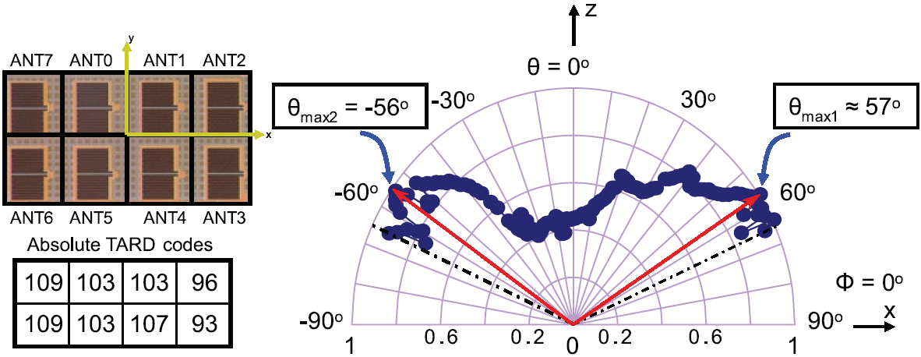
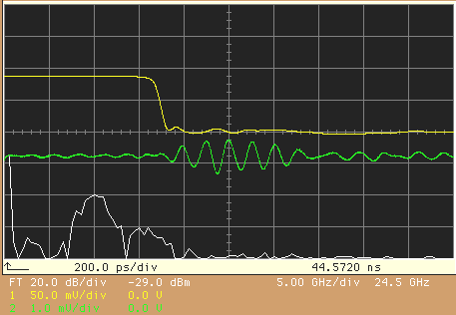
Radar Sensing radar application: Results
Transceiver, 65nm CMOS
Leakage Cancellation, 0.18um CMOS
d=25mm
Cal. for Tx
Rx’s Output
(by a Sampling Oscilloscope)
(Mai-Khanh, etc., SiRF Jun. 2013)
Transmitter, 18nm CMOS
received signal from horn antenna: V_{o}(p-p)=1.1mV
Center frequency : 10GHz
(Mai-Khanh, etc., RFIC Jun. 2013)
FFT of V_{o}(t)
(Mai-Khanh, etc., APMC 2012)

Slide 4

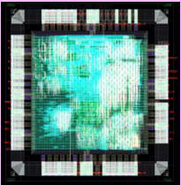
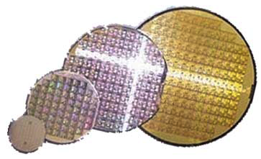

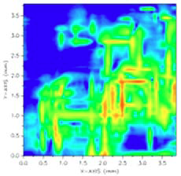




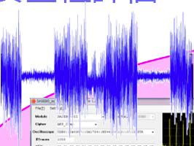
Magnetic Probe for Security Application
non-Destructive Attack/ Side-channel Attack
Abnormal behavior Detection/Failure Analysis
Fake LSI/Circuit Detection
electromagnetic emission
current, voltage
processing time
Cryptographic LSIs
Research target: evaluate and identify vulnerable electric-magnetic portions of cryptographic LSIs
Requirement:
Analog circuits/components:
Inductor/array
Amplifier, Mixer
Switching
Digital circuits (now)
Decoder
Register

Slide 5
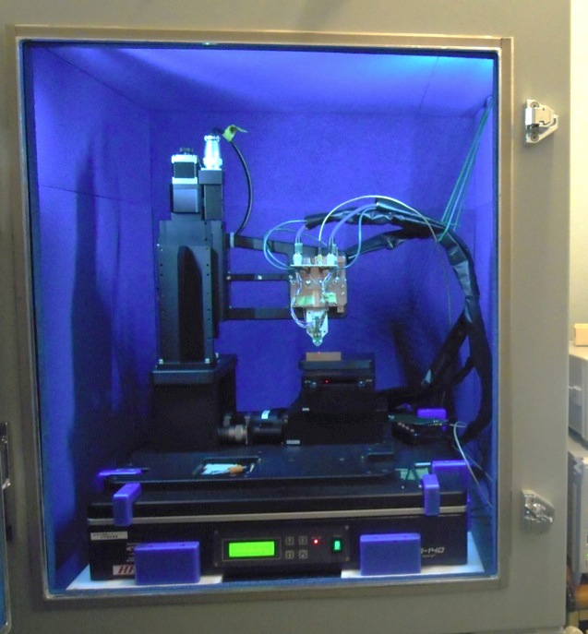
Magnetic Probe Results
Meas. in shielded box
Si-substrate removed by FIB process
with 128-bit AES
Magnetic map of the FPGA@72 MHz
(Mai-Khanh, etc., IEEE Sensor, 2013 and SAS, 2014

